Slide 1
HYPERSPECTRAL IMAGE CLASSIFICATION WITH HYBRIDSN MODEL AND COMPARISON OF GPU AND CPU DEPLOYMENT FOR THE TASK
CSE 372-INTRODUCTION TO HIGH PERFORMANCE COMPUTING

Slide 2
Hyperspectral Images

Slide 3
Spectral Signature

Slide 4
Convolutional Neural Network

Slide 5
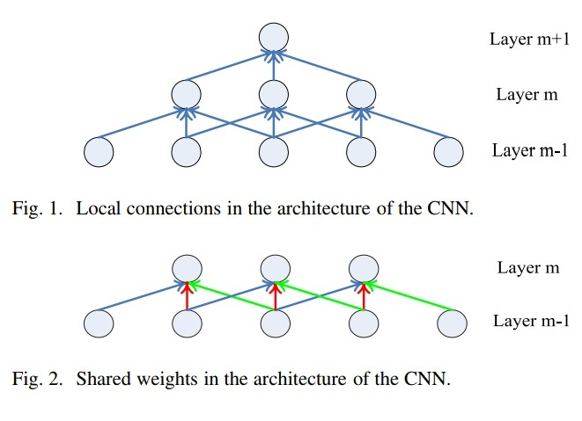
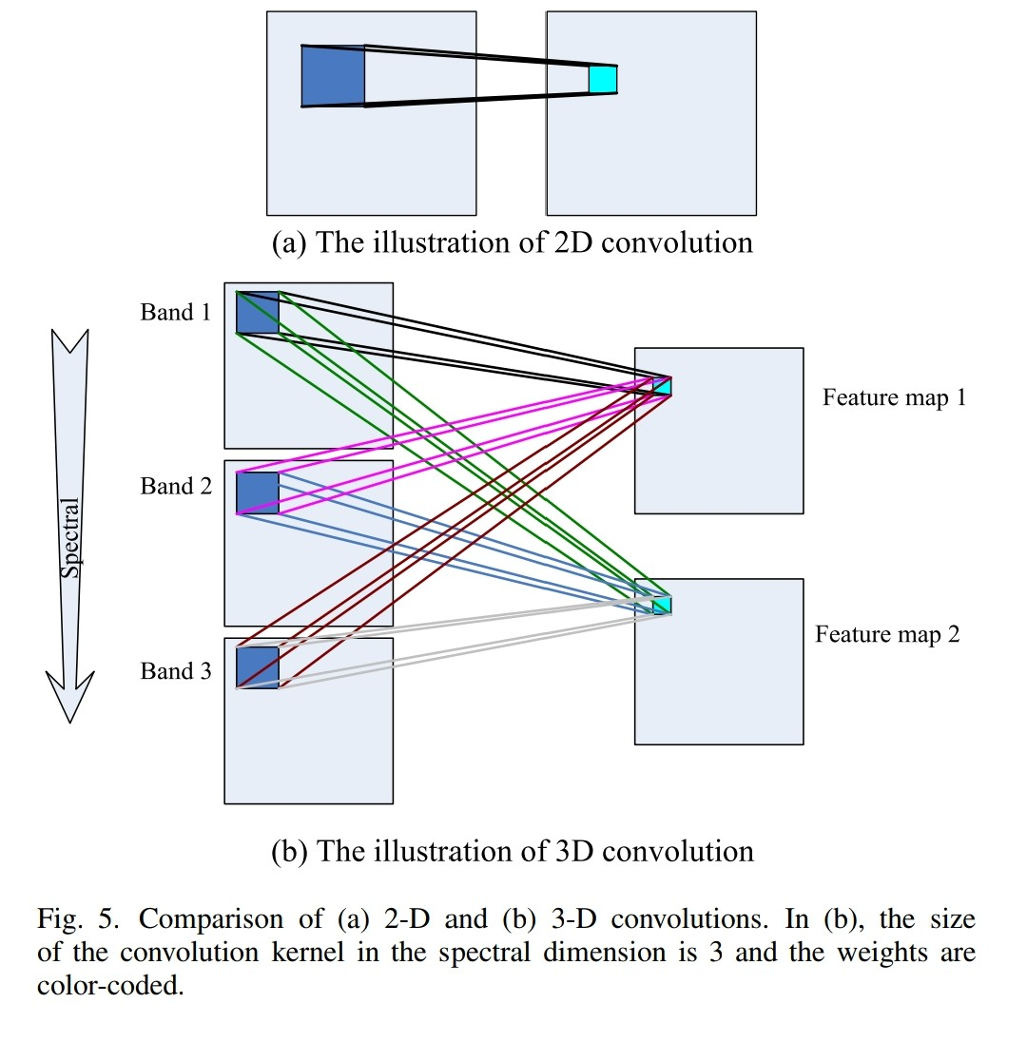

Slide 6
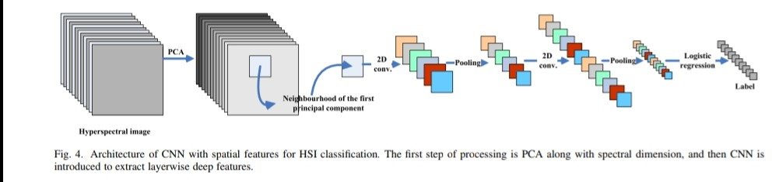

Slide 7
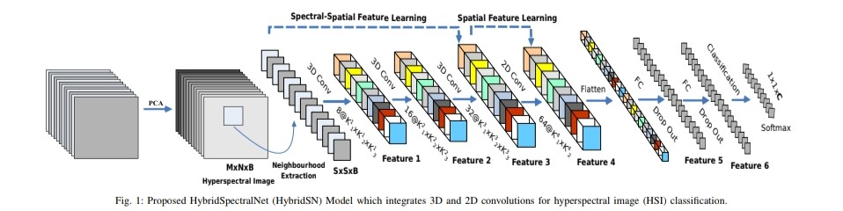
HybridSN Model

Slide 8


Result
Predicted Classification Ground Truth

Slide 9
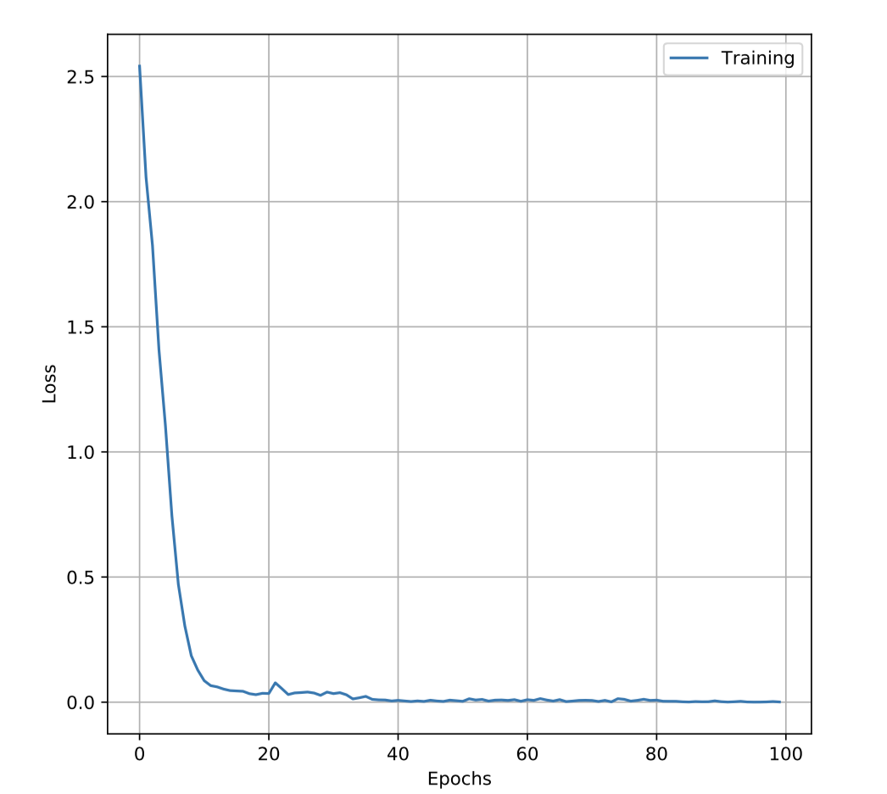
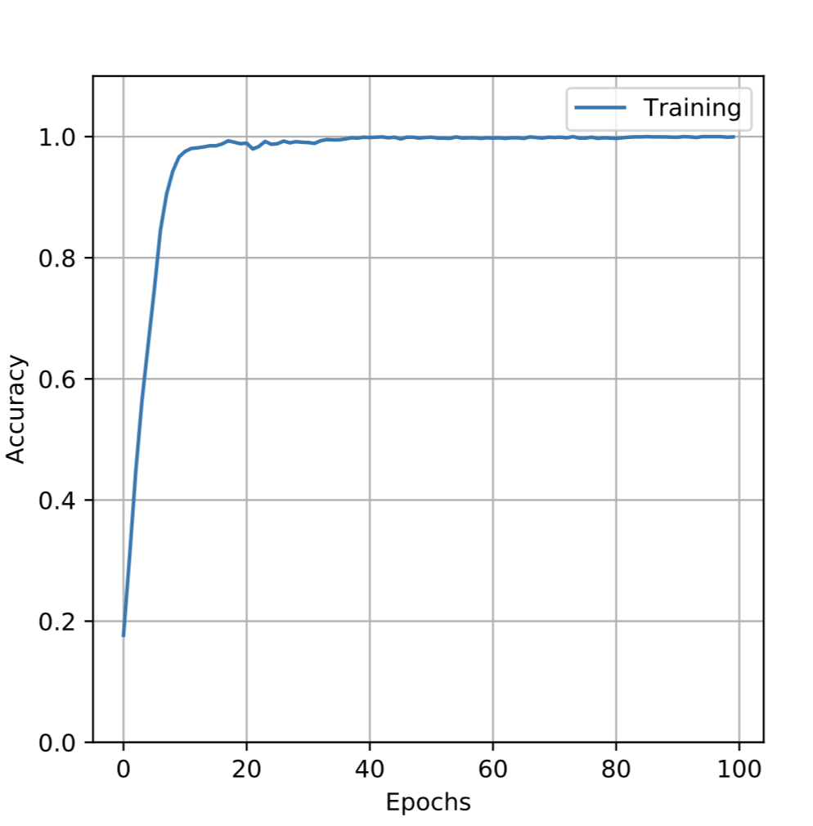
GPU Run result
Total gpu time: 171.15567111968994

Slide 10
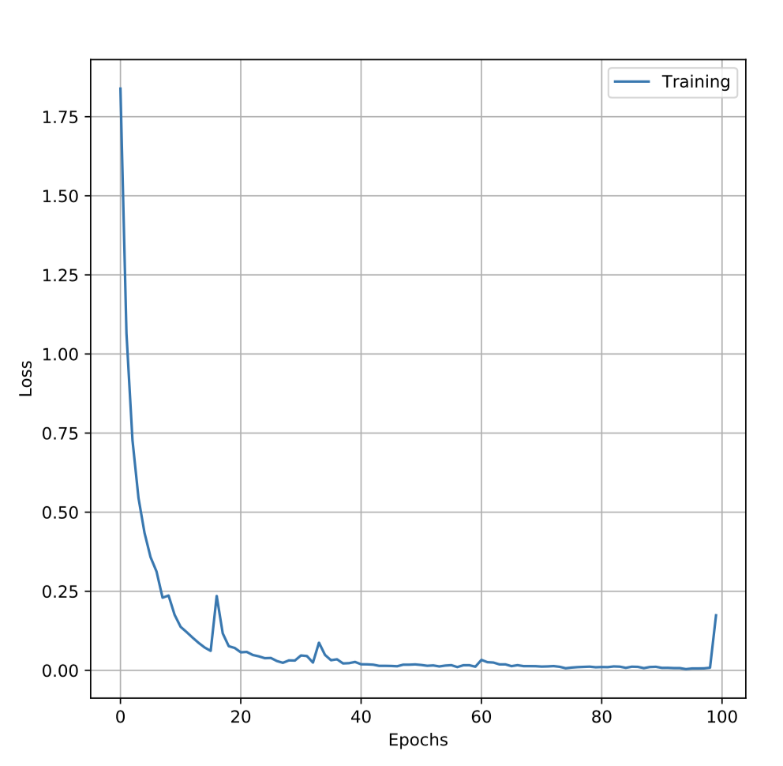
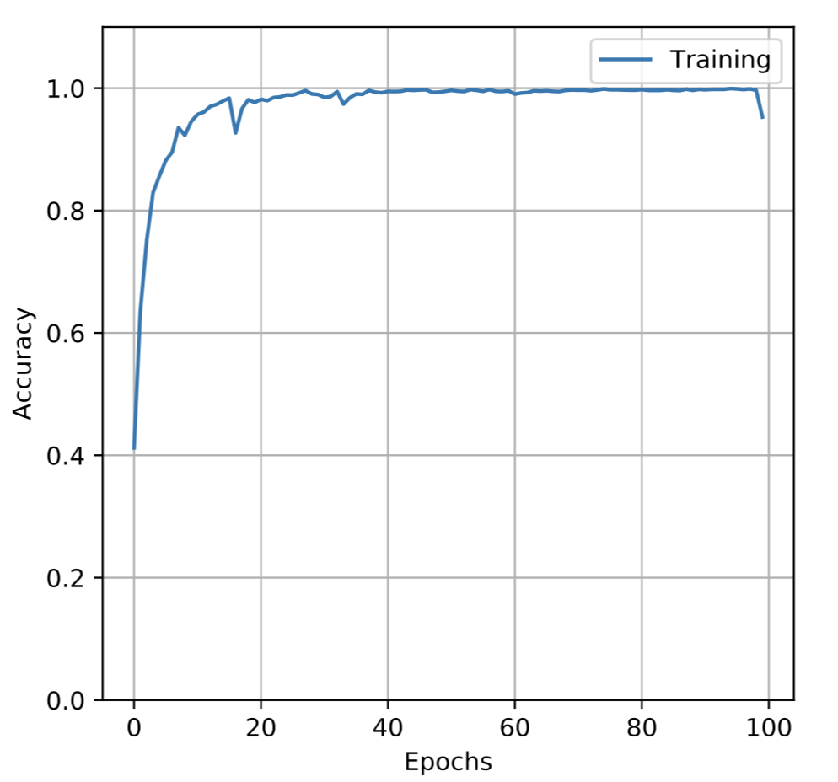
CPU Run result
Total cpu time: 19263.765327215195

Slide 11
Thank You

